Slide 1


DIGITAL RESEARCH SERVICES
RESEARCH FACILITATION TEAM
HOW CAN THE DIGITAL RESEARCH SERVICES HELP YOUR RESEARCH?
Dr André Vieira
Research Facilitator, CSE
18th October, School of Biological Sciences

Slide 2



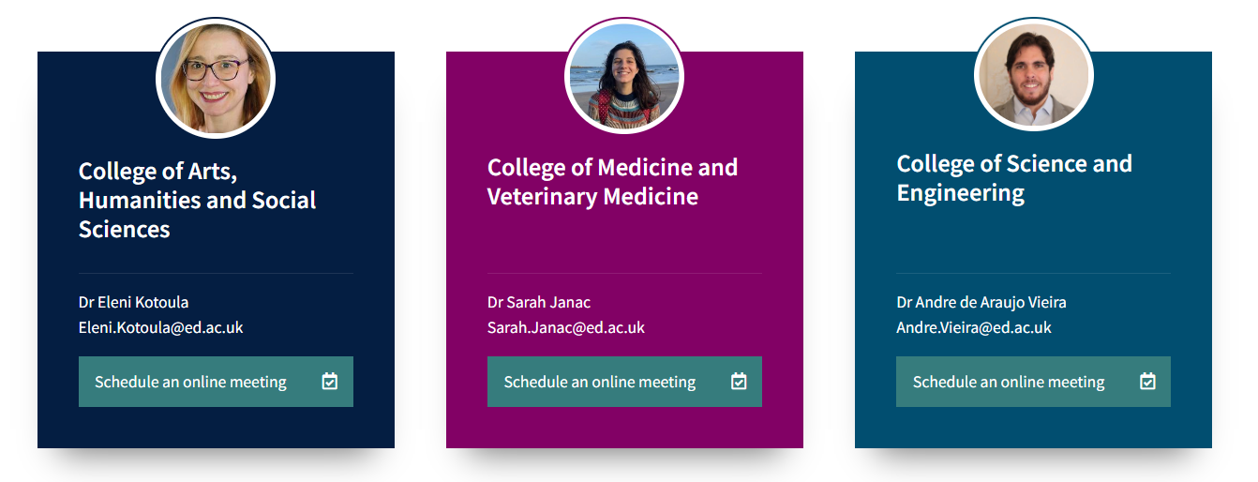
WHAT ARE DIGITAL RESEARCH SERVICES?
RESEARCH FACILITATOR ROLE
WEBSITE
PLAN FOR THIS ACADEMIC YEAR
PROMOTIONAL MATERIAL
Help you navigate the complex landscape of digital tools
Connect researchers and service providers
Tailored approach to the problem
Community Building & Networking
Produce digital resource-related training material
Dr André Vieira
Research Facilitator, CSE
Enhance the research with digital resources

Slide 3
PRESENTATION STRUCTURE
WHAT IS DIGITAL RESEARCH SERVICES?
RESEARCH FACILITATOR ROLE
WEBSITE
PLAN FOR THIS ACADEMIC YEAR
PROMOTIONAL MATERIAL
Dr André Vieira
Research Facilitator, CSE

Slide 4
WHAT ARE DIGITAL RESEARCH SERVICES?
RESEARCH FACILITATOR ROLE
WEBSITE
PLAN FOR THIS ACADEMIC YEAR
PROMOTIONAL MATERIAL
A single point of access to all of the data and computing services available to researchers at the University of Edinburgh.
Dr André Vieira
Research Facilitator, CSE

Slide 5
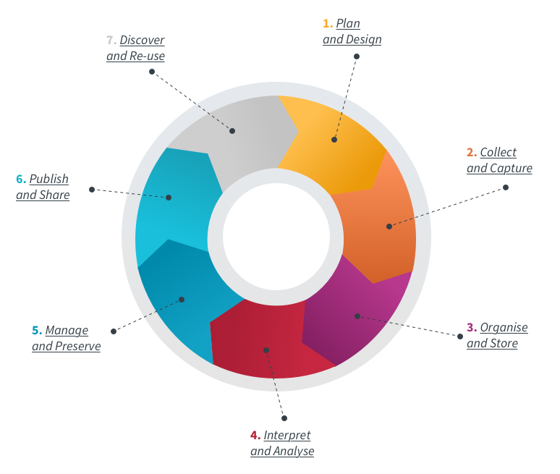
WHAT ARE DIGITAL RESEARCH SERVICES?
RESEARCH FACILITATOR ROLE
WEBSITE
PLAN FOR THIS ACADEMIC YEAR
PROMOTIONAL MATERIAL
Scale up research projects
Develop digital skills
Comply with best research practices and meet funder requirements
Become part of a research community
Share, publish and promote their work – open research
Dr André Vieira
Research Facilitator, CSE

Slide 6
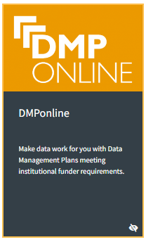

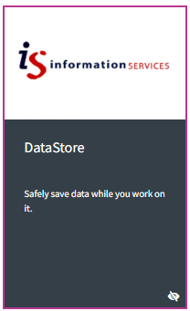
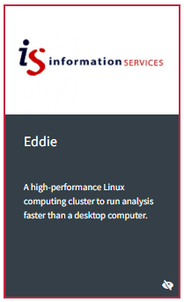
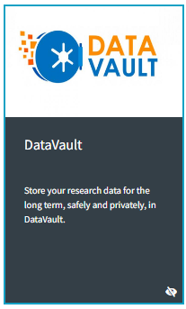

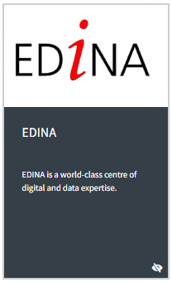




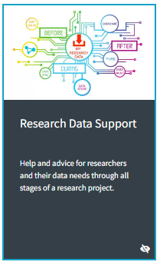

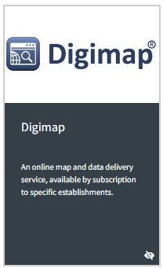
WHAT ARE DIGITAL RESEARCH SERVICES?
RESEARCH FACILITATOR ROLE
WEBSITE
PLAN FOR THIS ACADEMIC YEAR
PROMOTIONAL MATERIAL

Slide 7
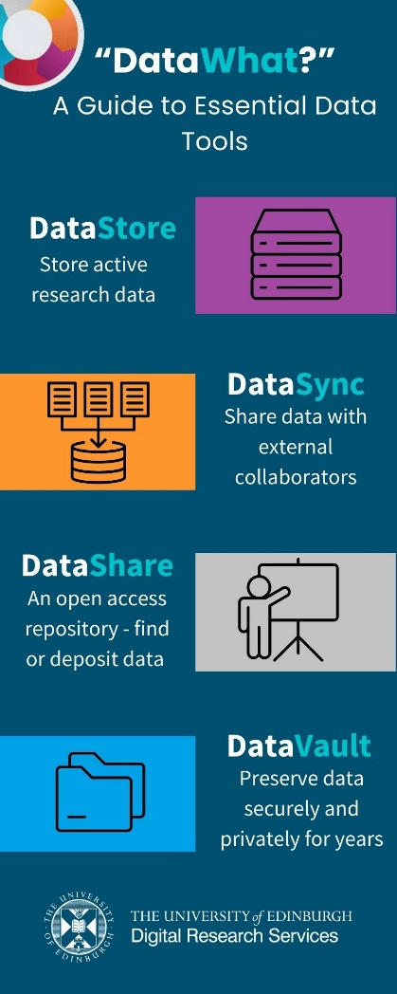

Slide 8
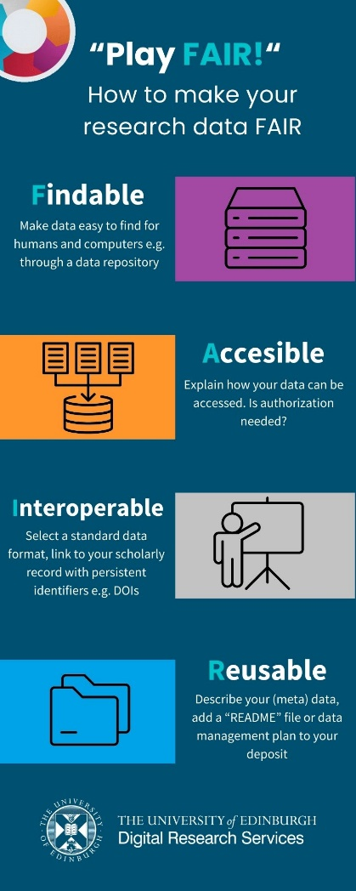
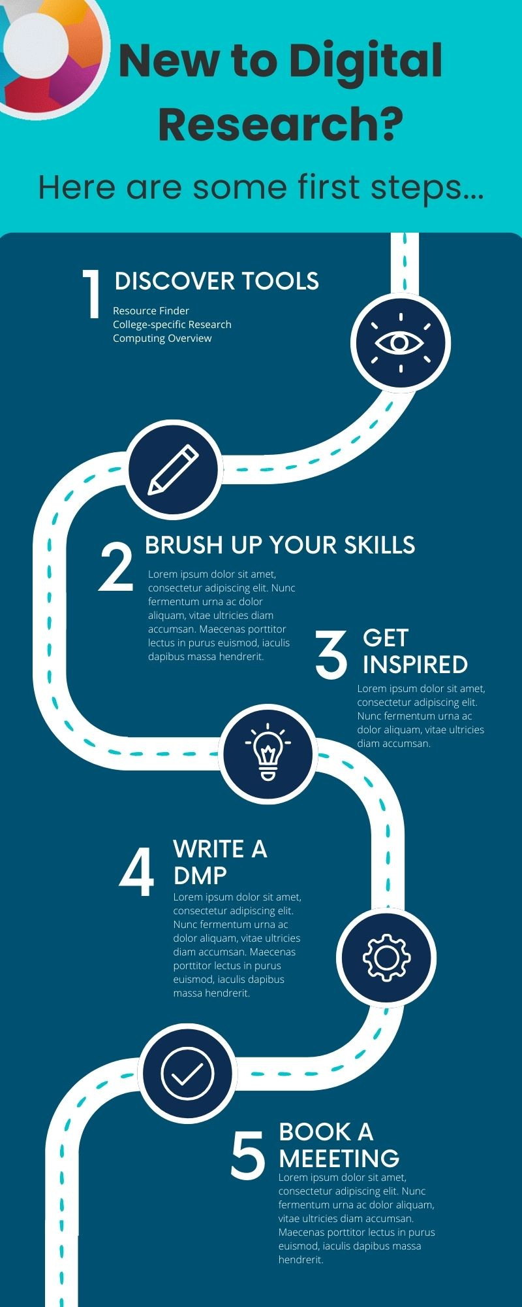
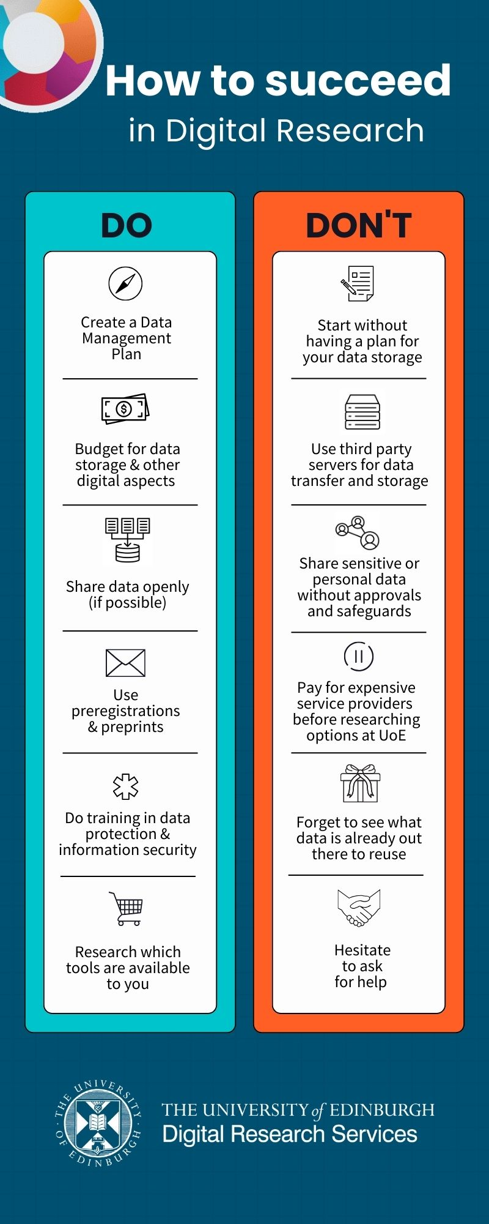
More Infographics

Slide 9
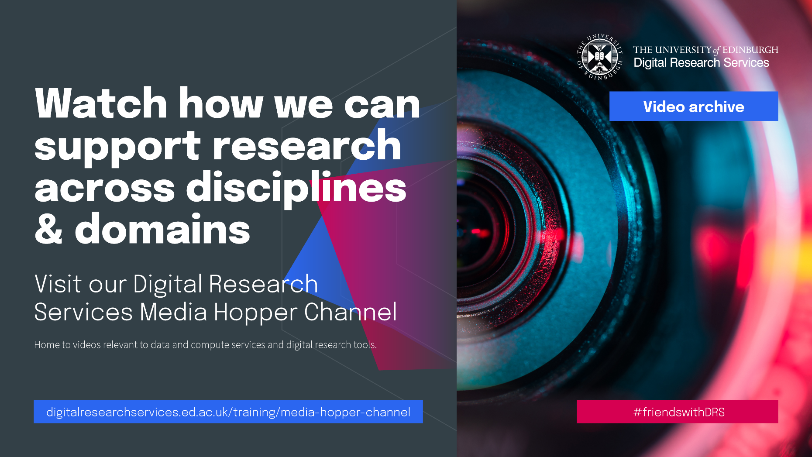

Slide 10

Keeping safe your project files and folders
Back up (almost) everything created by a human or recorded by a machine as soon as it is created.
Always backup your files in 3 places, at least one should be off-site.
USB sticks are a failure-prone option and are not a valid solution for backup of scientific data
A robust backup cannot be achieved manually – the University gives you DataStore
Slide provided by T. Zielinski
Notes:
Do you know how and where to keep 3 copies of your data which are always up to date?
Secure data preservation is very difficult to achieve without institutional support and know-how. One option is cloud storage, but not all data may be put in a public cloud.
You should always check your institutional guidelines and what solutions are available in your organisation.

Slide 11
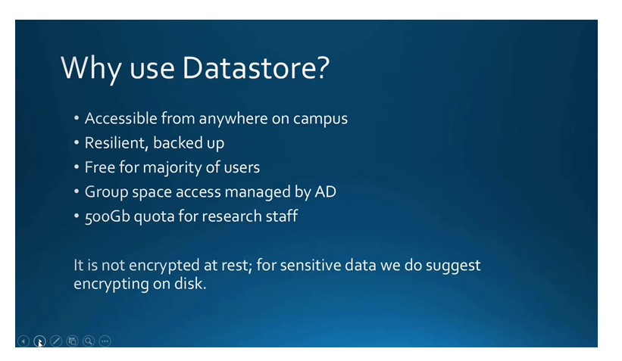
DataStore
Why use DataStore
Group space (\\csce.datastore.ed.ac.uk\csce\biology\groups\YOUR-GROUP)
Private (\\csce.datastore.ed.ac.uk\csce\biology\users\YOUR_LOGIN)
Useful resources
Introductory presentation
15 min Data Storage Options presentation login to Media Hopper to view
Instructions how to use:
https://www.ed.ac.uk/information-services/computing/desktop-personal/connect-uni-file-storage
BioRDM wiki (recipes for difficult use-cases)

Slide 12
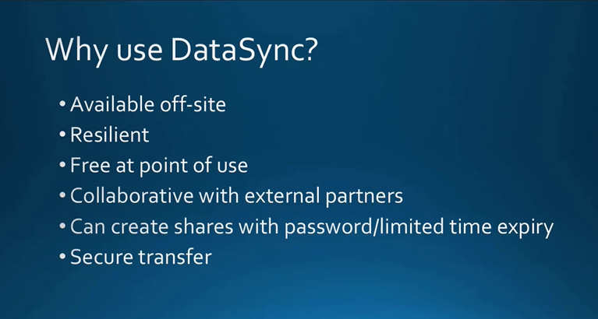
Why use Data Sync video

Slide 13
University resources - Collaboration
Sharepoint / OneDrive
https://uoe-my.sharepoint.com
For documents, presentations, reports, etc.
Excellent for collaborative work on shared documents
Online versions of Word / Excel
Your desktop Word can directly sync with sharepoint files
DON’T bounce emails with your PI – co-edit on sharepoint!!!
Slide provided by T. Zielinski

Slide 14
University resources - Collaboration
UoE WIKI
https://www.wiki.ed.ac.uk
projects’ websites,
making notes, organizing files,
even a simple ELN
(can be private or public)
https://www.wiki.ed.ac.uk/display/RDMS
Slide provided by T. Zielinski

Slide 15
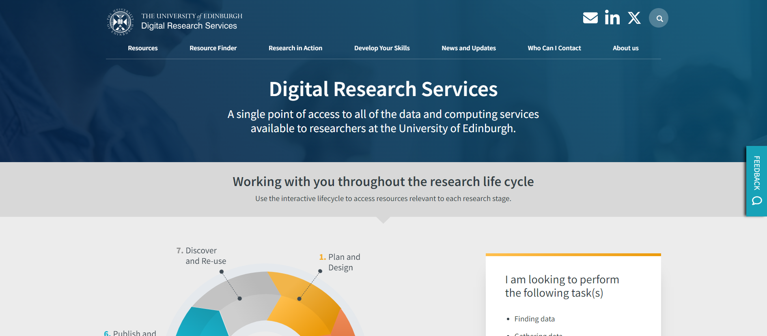
WHAT ARE DIGITAL RESEARCH SERVICES?
RESEARCH FACILITATOR ROLE
WEBSITE
PLAN FOR THIS ACADEMIC YEAR
PROMOTIONAL MATERIAL
Dr André Vieira
Research Facilitator, CSE
digitalresearchservices.ed.ac.uk/

Slide 16
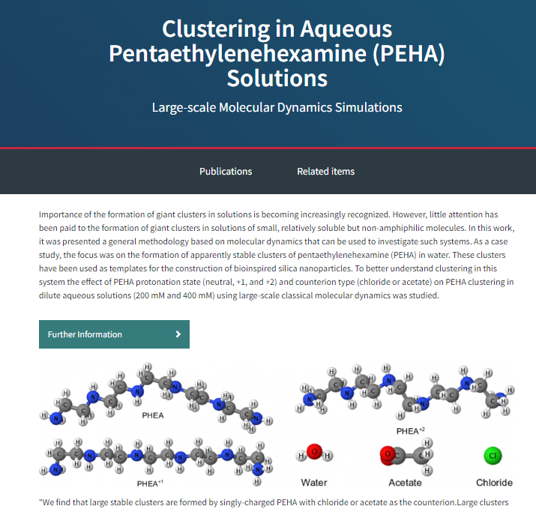
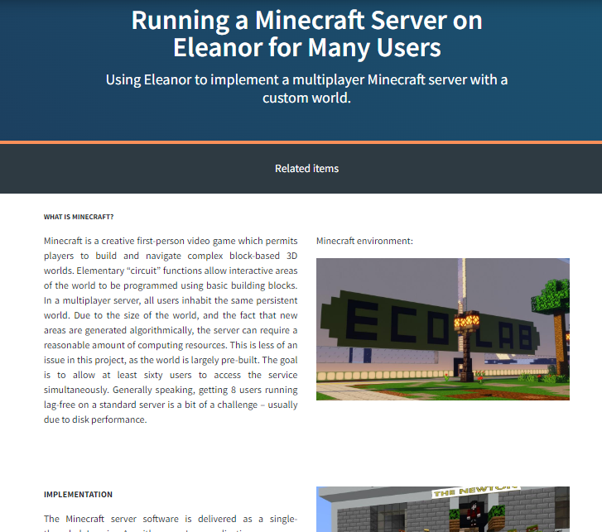
WHAT ARE DIGITAL RESEARCH SERVICES?
RESEARCH FACILITATOR ROLE
WEBSITE
PLAN FOR THIS ACADEMIC YEAR
PROMOTIONAL MATERIAL
RESEARCH IN ACTION
Dr André Vieira
Research Facilitator, CSE

Slide 17
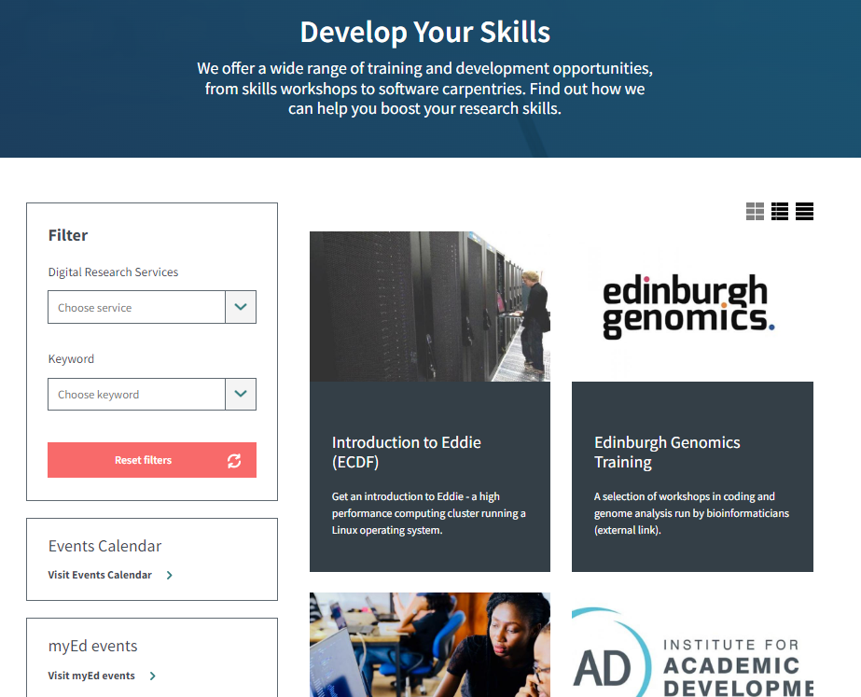
WHAT ARE DIGITAL RESEARCH SERVICES?
RESEARCH FACILITATOR ROLE
WEBSITE
PLAN FOR THIS ACADEMIC YEAR
PROMOTIONAL MATERIAL
Dr André Vieira
Research Facilitator, CSE

Slide 18
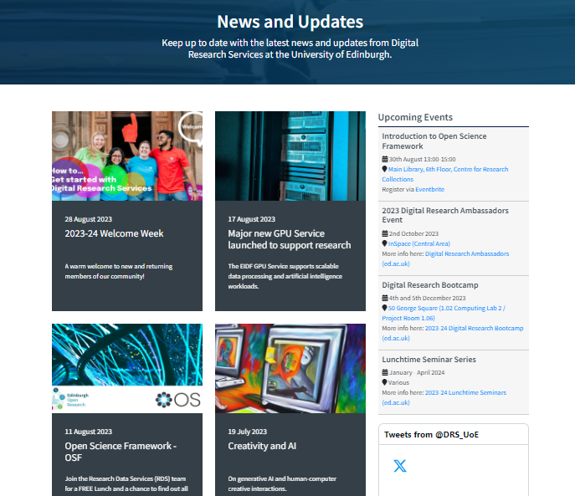
WHAT ARE DIGITAL RESEARCH SERVICES?
RESEARCH FACILITATOR ROLE
WEBSITE
PLAN FOR THIS ACADEMIC YEAR
PROMOTIONAL MATERIAL
Dr André Vieira
Research Facilitator, CSE

Slide 19
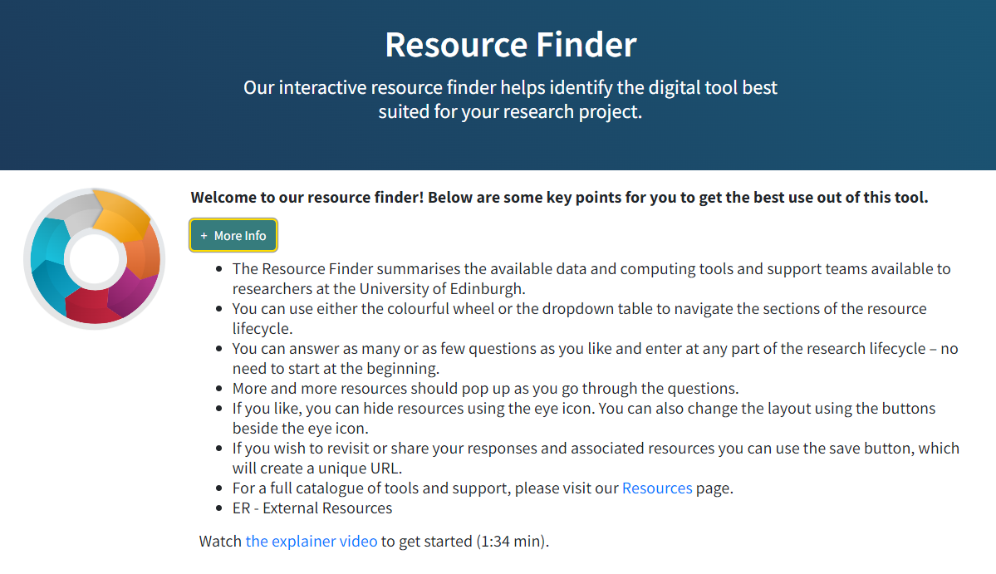
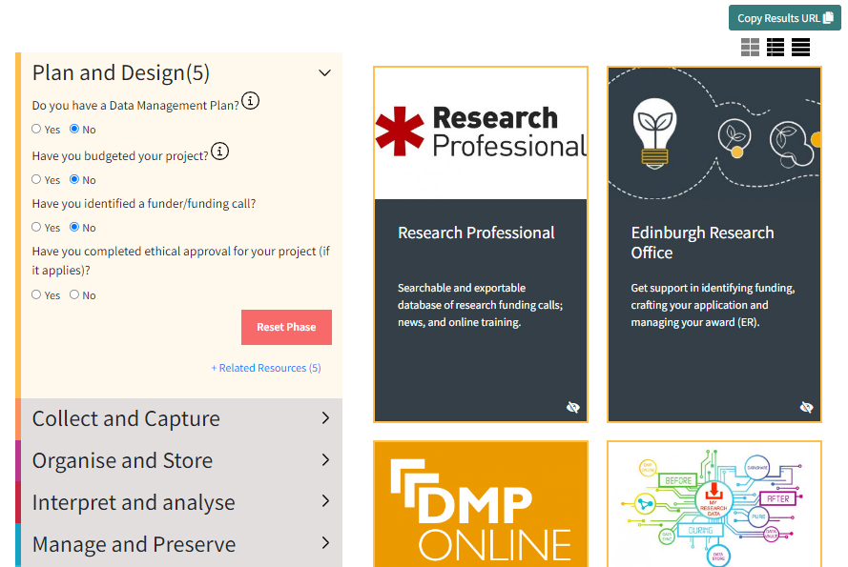
WHAT ARE DIGITAL RESEARCH SERVICES?
RESEARCH FACILITATOR ROLE
WEBSITE
PLAN FOR THIS ACADEMIC YEAR
PROMOTIONAL MATERIAL
Resource Finder
Dr André Vieira
Research Facilitator, CSE

Slide 20

WHAT ARE DIGITAL RESEARCH SERVICES?
RESEARCH FACILITATOR ROLE
WEBSITE
PLAN FOR THIS ACADEMIC YEAR
PROMOTIONAL MATERIAL
2023 – 2024 ACTIVITIES
Nov
Research In Action Events
Jan - Apr
Lunchtime Seminars
Jan - Jun
2024 DRS Ambassadors Programme
December
DRS Bootcamp
Dr André Vieira
Research Facilitator, CSE

Slide 21
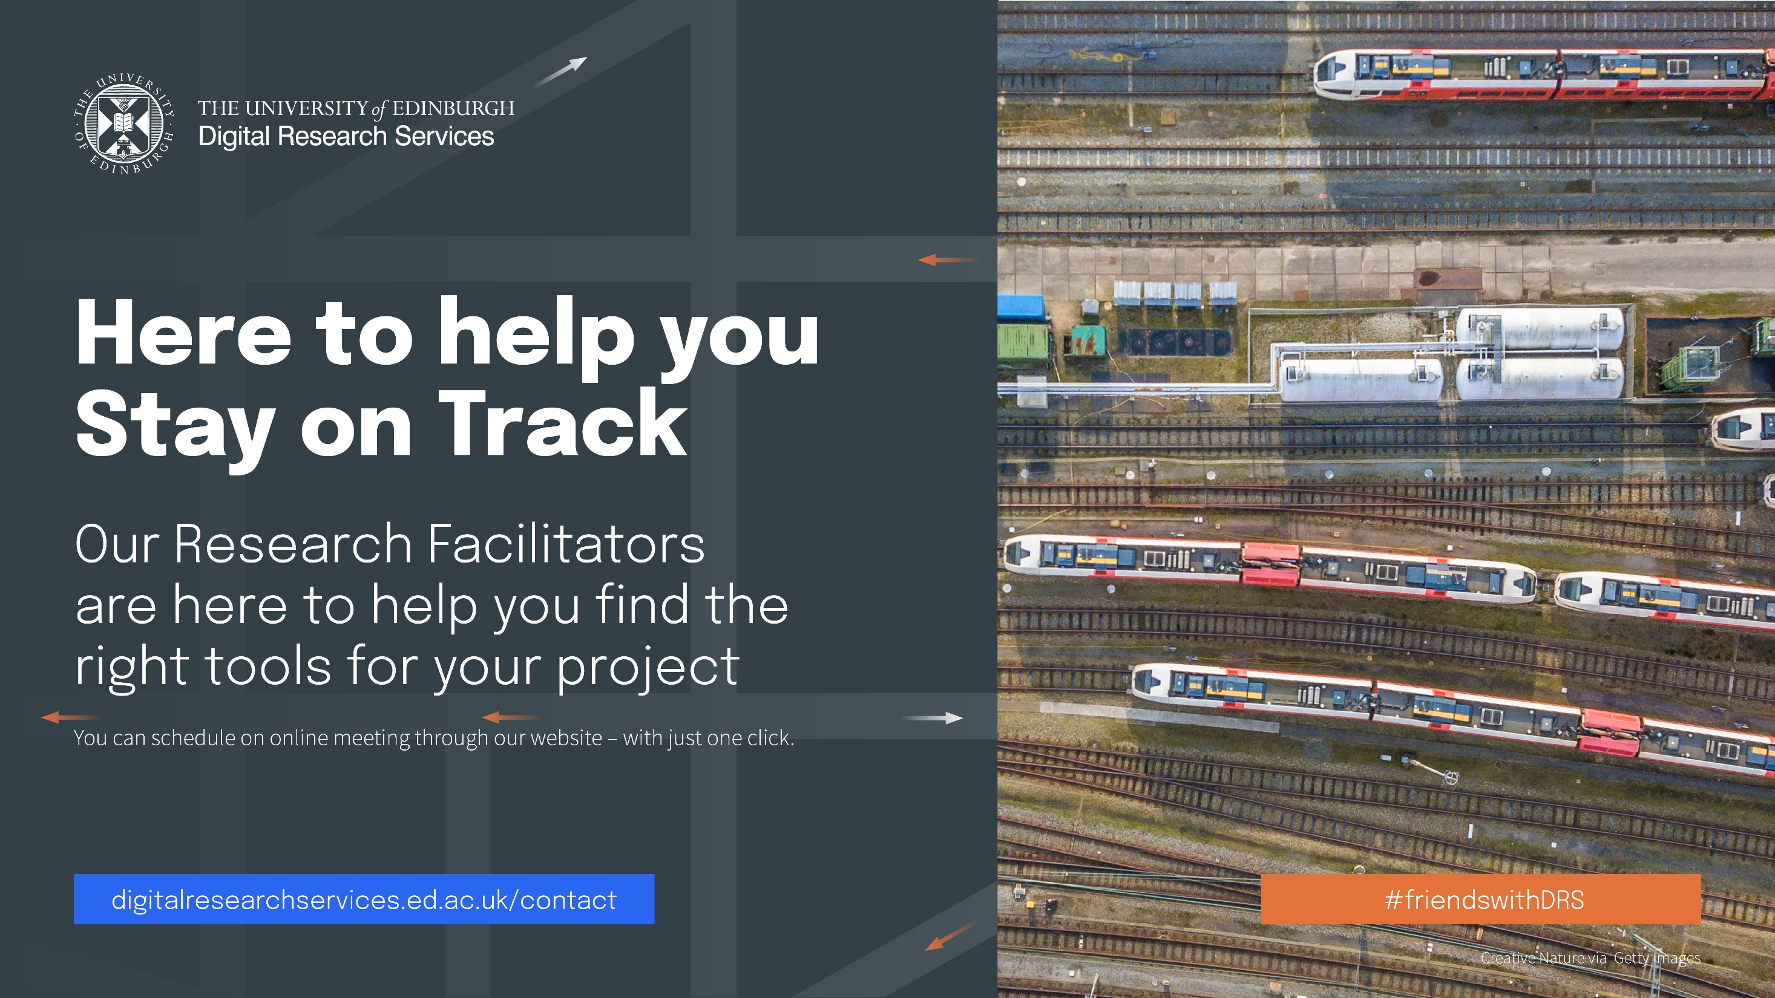
WHAT ARE DIGITAL RESEARCH SERVICES?
RESEARCH FACILITATOR ROLE
WEBSITE
PLAN FOR THIS ACADEMIC YEAR
PROMOTIONAL MATERIAL
Dr André Vieira, Research Facilitator, CSE

Slide 22

WHAT ARE DIGITAL RESEARCH SERVICES?
RESEARCH FACILITATOR ROLE
WEBSITE
PLAN FOR THIS ACADEMIC YEAR
PROMOTIONAL MATERIAL
Dr André Vieira, Research Facilitator, CSE

Slide 23

WHAT ARE DIGITAL RESEARCH SERVICES?
RESEARCH FACILITATOR ROLE
WEBSITE
PLAN FOR THIS ACADEMIC YEAR
PROMOTIONAL MATERIAL
Dr André Vieira, Research Facilitator, CSE

Slide 24

WHAT ARE DIGITAL RESEARCH SERVICES?
RESEARCH FACILITATOR ROLE
WEBSITE
PLAN FOR THIS ACADEMIC YEAR
PROMOTIONAL MATERIAL
Dr André Vieira, Research Facilitator, CSE

Slide 25

WHAT ARE DIGITAL RESEARCH SERVICES?
RESEARCH FACILITATOR ROLE
WEBSITE
PLAN FOR THIS ACADEMIC YEAR
PROMOTIONAL MATERIAL
Dr André Vieira, Research Facilitator, CSE

Slide 26

WHAT ARE DIGITAL RESEARCH SERVICES?
RESEARCH FACILITATOR ROLE
WEBSITE
PLAN FOR THIS ACADEMIC YEAR
PROMOTIONAL MATERIAL
Dr André Vieira, Research Facilitator, CSE

Slide 27







https://mlist.is.ed.ac.uk/lists/subscribe/digitalresearch
https://uoe.sharepoint.com/sites/DRSFacilitation
https://www.digitalresearchservices.ed.ac.uk/
https://www.linkedin.com/company/DRS_UoE
https://twitter.com/DRS_UoE
andre.vieira@ed.ac.uk / digitalresearchservices@ed.ac.uk
THANK YOU!

Slide 28
DIGITAL RESEARCH SERVICES
RESEARCH FACILITATION TEAM
HOW CAN THE DIGITAL RESEARCH SERVICES HELP YOUR RESEARCH?
Dr André Vieira
Research Facilitator, CSE

